Slide 1


Slide 2


Slide 3
This is my bible, I am what it says I am. I can do what it says I can do. Today, I will be taught of the word of GOD. I boldly confess my mind is alert, my heart is receptive, i will never be the same I am about to receive

Slide 4
The incorruptible, indestructible, ever living seed of the word of GOD. I will never be the same again never, never, never I will never be the same no turning back In JESUS name. Amen!

Slide 5

\

Slide 6
2 Corinthians 4:4 NIV
The god of this age has blinded the minds of unbelievers, so that they cannot see the light of the gospel that displays the glory of Christ, who is the image of God.

Slide 7
John 12:31 NIV
Now is the time for judgment on this world; now the prince of this world will be driven out.

Slide 8
1 John 5:19 NIV
We know that we are children of God, and that the whole world is under the control of the evil one.

Slide 9
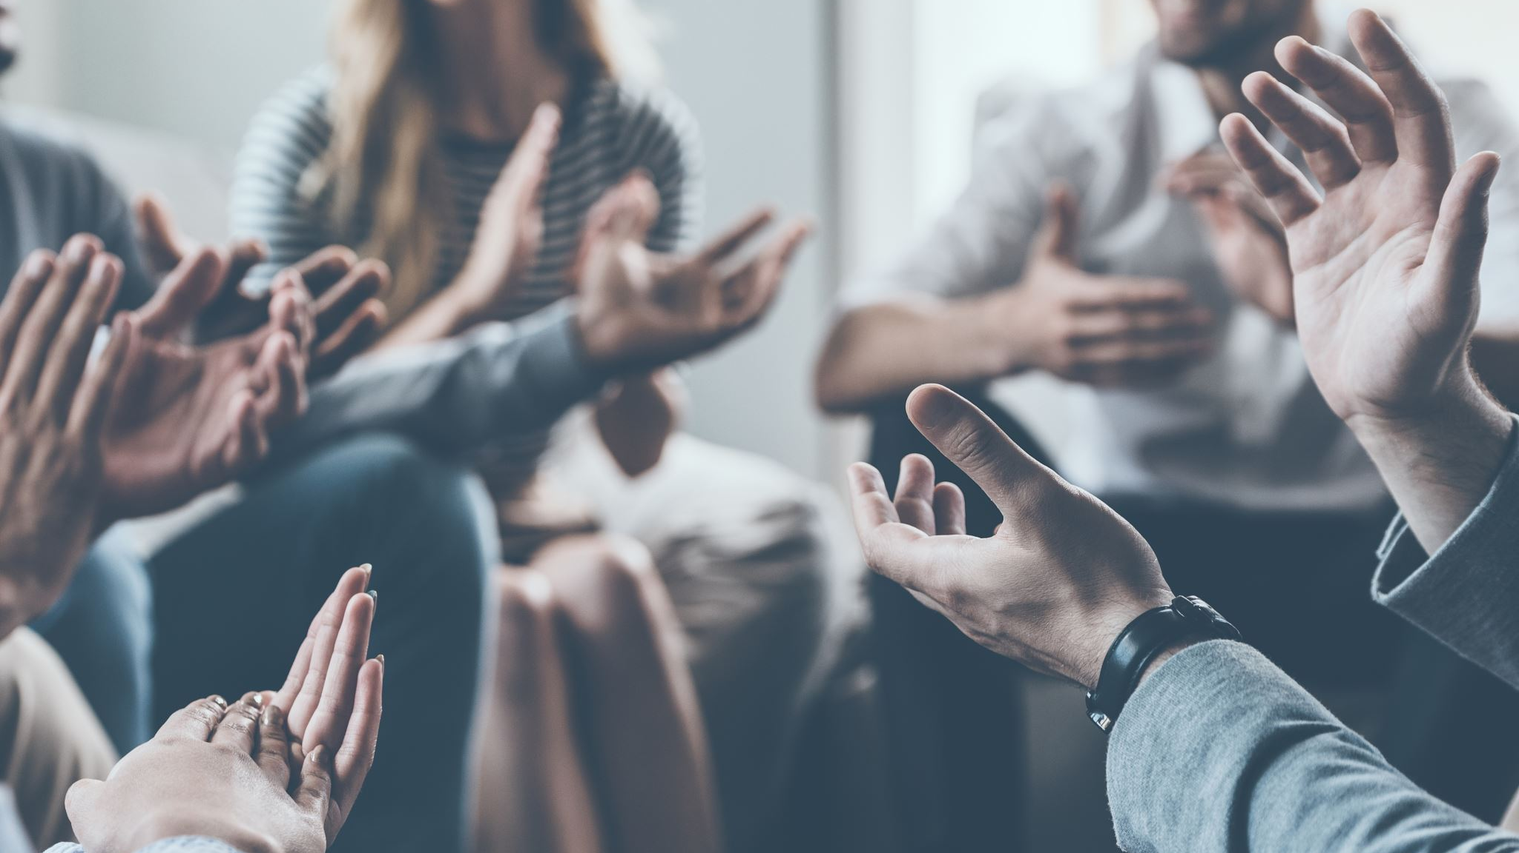
Optimism is Positive Thinking Hope is Passionate Trusting

Slide 10
2 Timothy 1:12 GNT
and it is for this reason that I suffer these things. But I am still full of confidence, because I know whom I have trusted, and I am sure that he is able to keep safe until that Day what he has entrusted to me.

Slide 11

1. That GOD choose you before You choose Him.

Slide 12
Psalm 115:8 GNT
May all who made them and who trust in them
become like the idols they have made.

Slide 13
1 Peter 1:2 GNT
² You were chosen according to the purpose of God the Father and were made a holy people by his Spirit, to obey Jesus Christ and be purified by his blood.
May grace and peace be yours in full measure.

Slide 14
2. Because your Salvation depends on what LORD JESUS said and did.

Slide 15
Hebrews 12:2 GNT
Let us keep our eyes fixed on Jesus, on whom our faith depends from beginning to end. He did not give up because of the cross! On the contrary, because of the joy that was

Slide 16
Luke 19:1-10 NIV
Jesus entered Jericho and was passing through.2 A man was there by the name of Zacchaeus; he was a chief tax collector and was wealthy. 3 He wanted to see who Jesus was, but because he was short he could not see over the crowd. 4 So he ran ahead and climbed a sycamore-fig tree to see him, since Jesus was coming that way.

Slide 17
Luke 19:1-10 NIV
5 When Jesus reached the spot, he looked up and said to him, “Zacchaeus, come down immediately. I must stay at your house today.” 6 So he came down at once and welcomed him gladly.
7 All the people saw this and began to mutter, “He has gone to be the guest of a sinner.”

Slide 18
Luke 19:1-10 NIV
8 But Zacchaeus stood up and said to the Lord,“Look, Lord! Here and now I give half of my possessions to the poor, and if I have cheated anybody out of anything, I will pay back four times the amount.”
9 Jesus said to him, “Today salvation has come to this house, because this man, too, is a son of Abraham. 10 For the Son of Man came to seek and to save the lost.”

Slide 19
Revelation 3:20 NIV
Here I am! I stand at the door and knock. If anyone hears my voice and opens the door, I will come in and eat with that person, and they with me.

Slide 20
What caused Zacchaeus(people) that matter to be Saved?

Slide 21
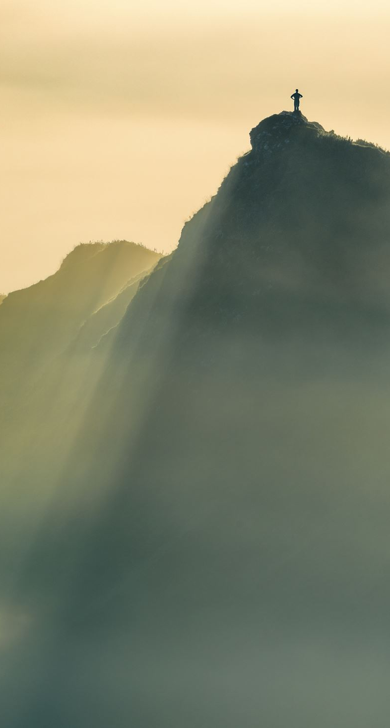
1. THE DESIRE TO SEE JESUS.

Slide 22
Luke 19:3-4 NIV
3 He wanted to see who Jesus was, but because he was short he could not see over the crowd. 4 So he ran ahead and climbed a sycamore-fig tree to see him, since Jesus was coming that way.

Slide 23
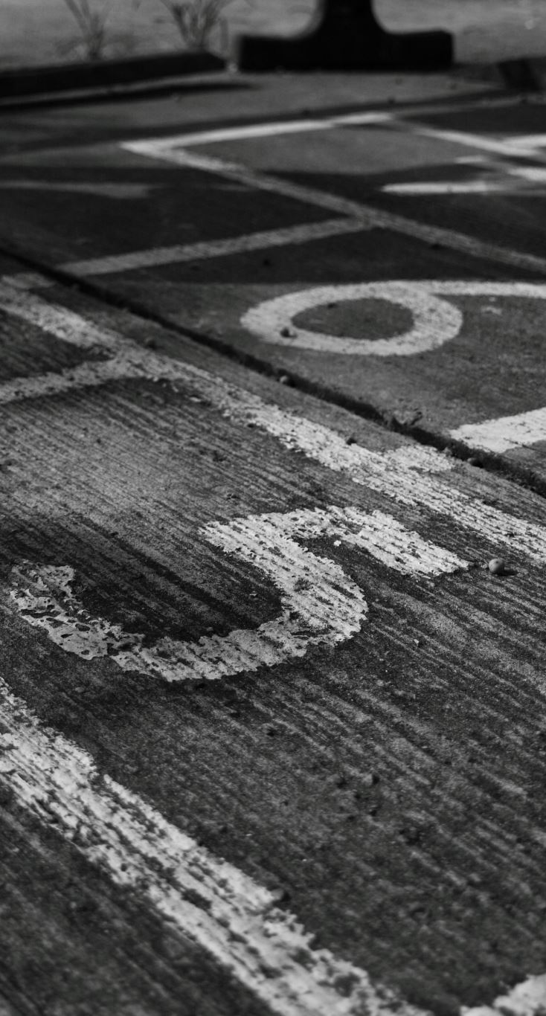
2. HE STEP INTO RIGHT DIRECTION

Slide 24
Proverbs 14:12 NKJV
There is a way that seems right to a man,
But its end is the way of death.

Slide 25
Luke 19:5-6 NIV
5 When Jesus reached the spot, he looked up and said to him, “Zacchaeus, come down immediately. I must stay at your house today.” 6 So he came down at once and welcomed him gladly.

Slide 26
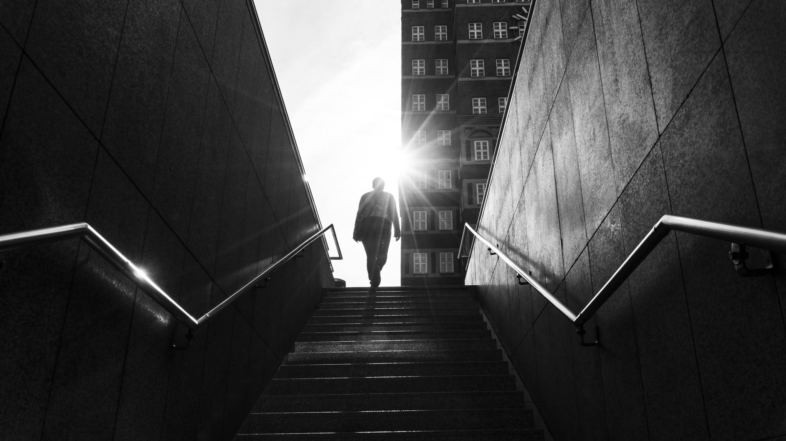
“JUST A SMALL STEP OF FAITH MEET A RESPONSE OF THE LORD JESUS”

Slide 27
3. JUST BELIEVE THE WORD OF THE LORD JESUS

Slide 28
Luke 19:9-10 NIV
9 Jesus said to him, “Today salvation has come to this house, because this man, too, is a son of Abraham. 10 For the Son of Man came to seek and to save the lost.”

